Slide 1

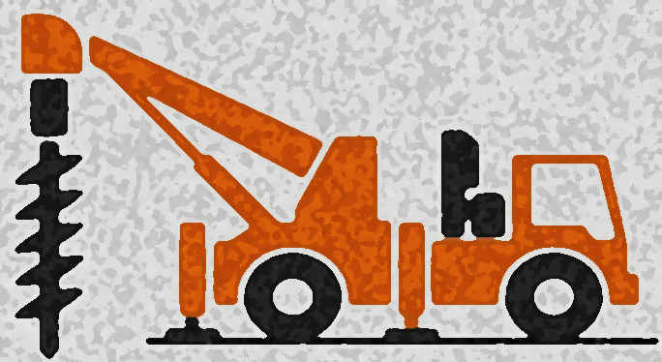
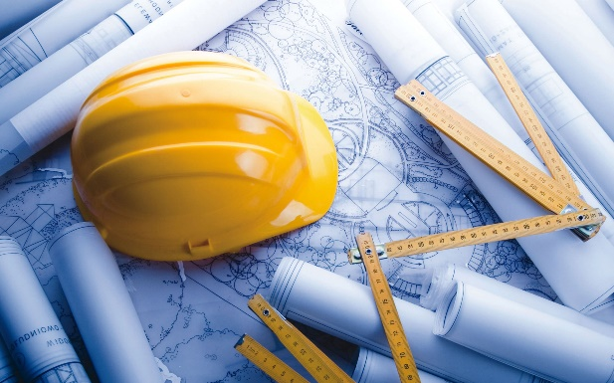
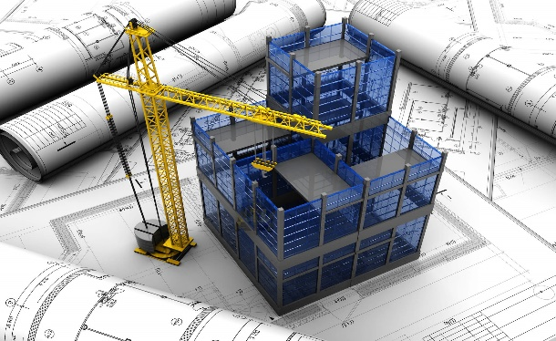
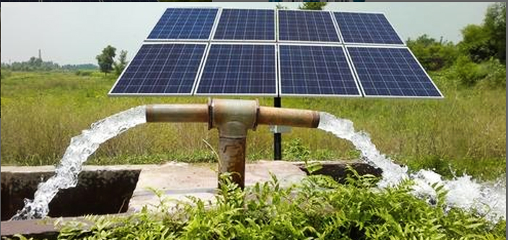

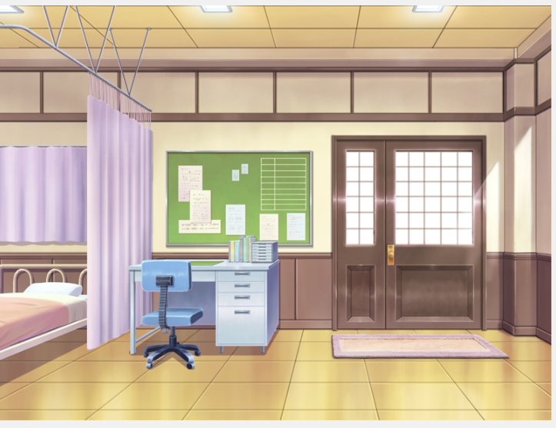
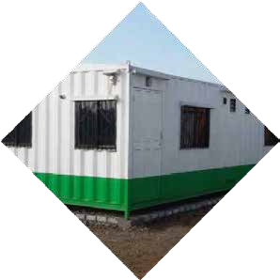


Integrated Civil Solutions
A registered company with well- reputed name in the Business of General
Our thruﬆ is to deliver with higheﬆ regard to quality
Honesty, integrity and Customer Satisfaction.
A brief introduction

Slide 2


“We simply want to make what they want”
“Be Kind with all kind”

Slide 3
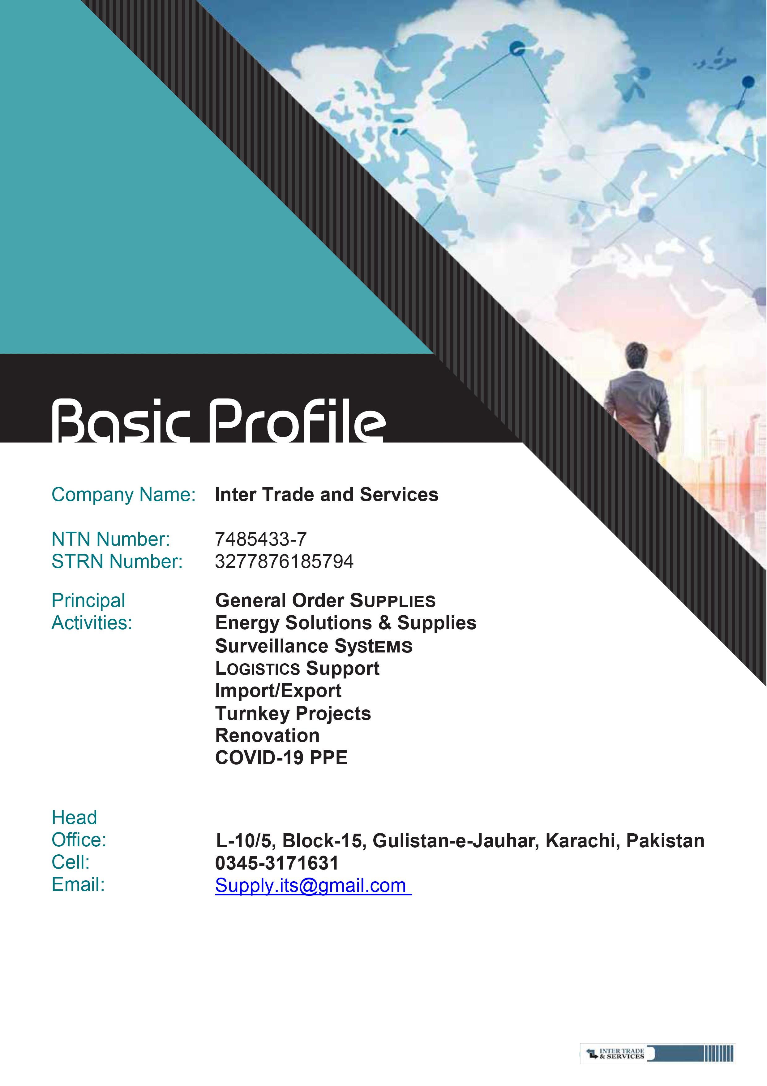
Company Name: G&G Engineers
NTN: 4552404
PEC Reg. #: CONTRACTOR-79451
SNTN (SRB): 4552404-2
Registered in Sales TAX: (GST)
Principal Activities: Complete Civil Engineering Contracting Works
Geotech-Soil (Drilling & Testing)
Hydro-Wells Integrated Solutions
Mineral Exploration & Surveys
Land & Airborne Surveys
Geophysical Surveys
Advance DAM Geophysics
General Order Supplies
Energy Solutions & Supply
Surveillance Systems
Logistics Supports
Import/ Export
Turnkey Projects
Renovations
Head Office: C-24/5, Gulshan-e-Iqbal, Karachi
Contact #: 0312-2769796
Email: info@gngengineer.com

Slide 4
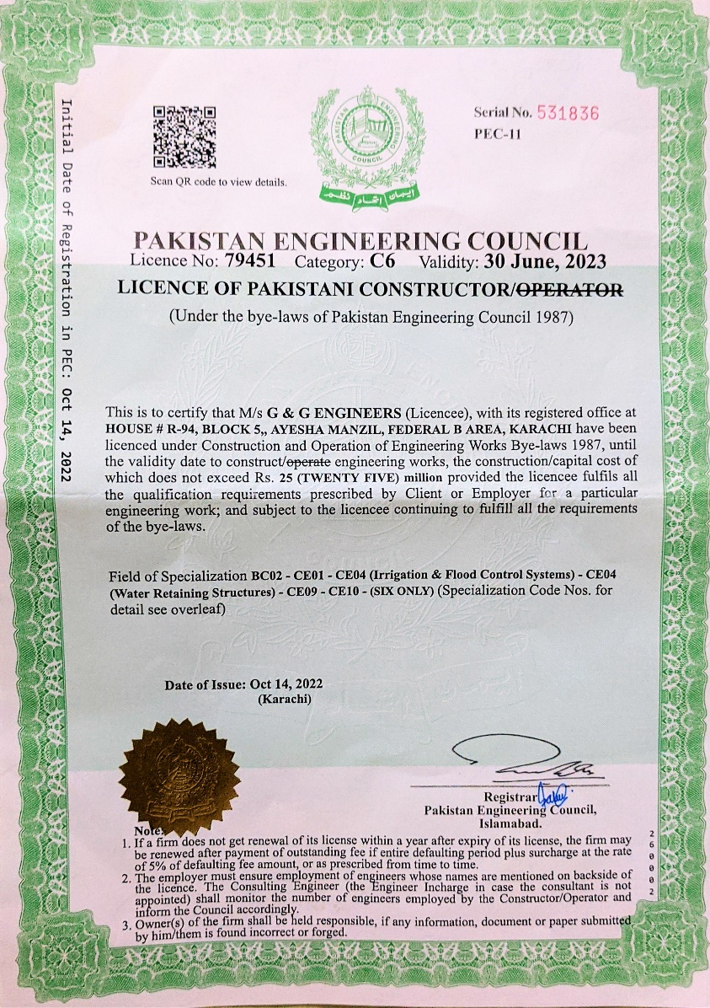
Pakistan Engineering Council
Contractor License
Pakistan Engineering Council
Registration Categories
CE10
General Civil Engineering Works
Concrete Repairs
Soil Investigation And Stabilization
Landscaping And Horticulture
Reclamation Works
General Building And Maintenance
Water Proofing
BC01
Prefabricated Buildings, Steel Framed
Building And Industrial Plants
CE01:
Roads And Pavements
Drainage And Retaining Structure
Sign Craft Installation
CE04:
DAMS/Water Retaining Structures
Irrigation And Flood Control Systems
CE09:
Sewerage Works
Water Supply

Slide 5



G&G Engr’s is a multidisciplinary services company which provides solutions with an integrated approach of GEOLOGY, GEOPHYSICS and DRILLING domain covering CIVIL engineering aspects to a reliable project delivery in the evolving globalized world.
Proactive rather than reactive, we are at the forefront of new specialties and advantageous alliances. Our services are distinctive as they are continuous.
Our portfolio exhibits four different sectors which include Geosciences-Geotechical, Civil Engineering, Drilling & Supplies
We adopt state-of-the-art technology which enable us towards new techniques and methods to be introduced in Pakistan to provide solutions of current era.
To be the best service provider company in Pakistan with emphasis
on Quality, Honeﬆy and Professionalism.

Slide 6
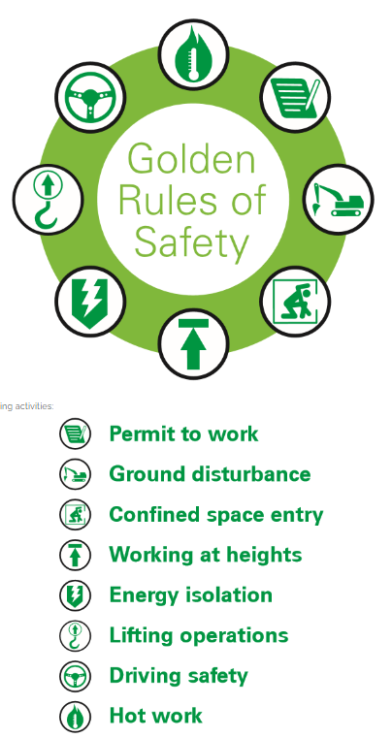

Health Safety and Environment Policy
G&G Engr’s is a safely conscious entity committed to maintaining the highest standards of HS&E in the industry in order to eliminate conditions and incidents that could result in personal injury, ill health or damage to the environment.
G&G Engr's believes that the health and safety of its employees is of prime importance to the success of its operations. The company is committed to conduct its operations in a safe and productive manner that will not hurt people or endanger their life,
To ensure a very high standard of safety and health is maintained, We as a company is committed to the following:
All equipment shall be maintained in a safe operating condition
All workers and others shall be always physically and mentally fit for work.
All accidents / incidents and near misses shall be reported and investigated
Provide information to employees on potential hazards in the workplace.
All employees shall follow nominated safe working procedures,
All employees shall wear required protective clothing.
All employees shall care for the safety and health of fellow employees
The hierarchy of hazard control shall be always applied to risk management.
Standard Work Procedures shall be developed, implemented and regularly reviewed
Company Resolution

Slide 7

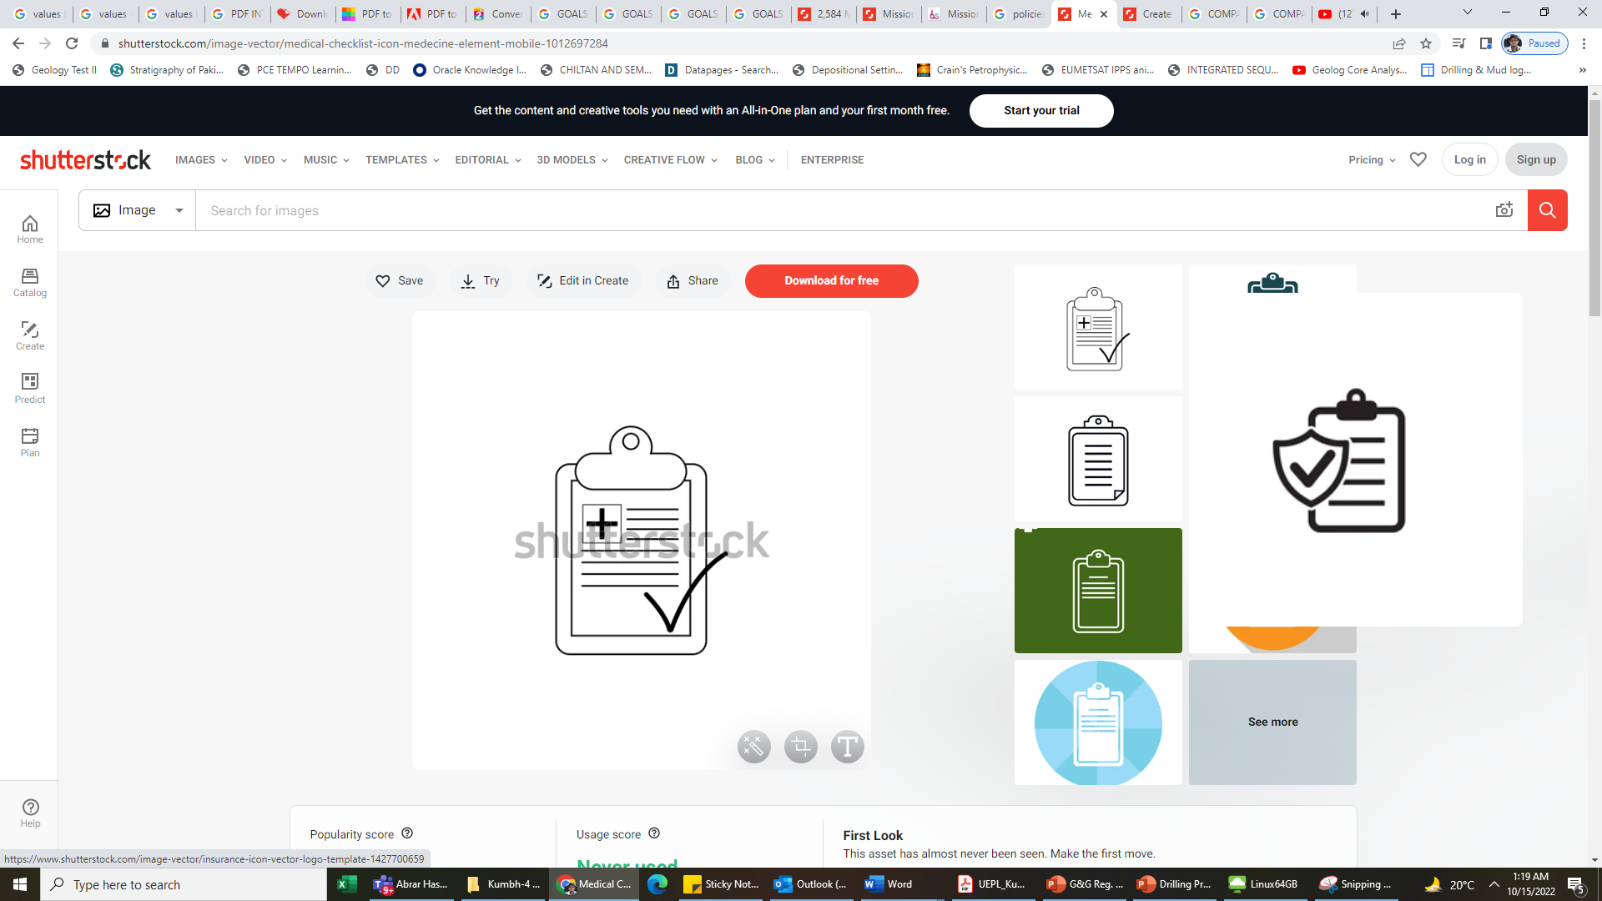
Company Boards
OUR GOALS
G&G Engr’s strives to offer a full integrated Geosciences, Drilling, Advance Geotechnical and Civil engineering services & Supplies for the civil sector in an economical and professional manner and to develop and support every aspect of our business with the highest Level of integrity remain dedicated to our clients as business partners along with the focus on environmental protection.
OUR VISION
To grow sustainably and become the premier and the leading company in all our portfolio sector in Pakistan
To reach the superior Level in exploration, drilling, engineering and mining and supplies services and to be elevated by our customers as the best business partner
To be a Leader in innovation, service and quality
OUR BUSINESS POLICY
To meet the expectations of our clients perfectly on time on each occasion to supply them with the best service which is respectful to the natural environment, which will ensure the highest customer satisfaction in terms of aesthetics and function.
“Upgrade the level of integration and technologies
according to the level of developed countries”

Slide 8

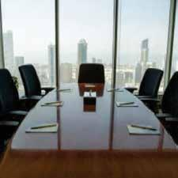
CEO’s Message
As “G&G Engr’s We Value Our client that is why achieving satisfaction to client is the first and utmost priority of our company and how we aspire to do business every day
WILLPOWER AND DETERMINATION
A strong will means we use our drive and commitment to energize, engage and inspire others.
ACCOUNTABILITY
Delivering our very best in all we do, holding ourselves accountable for results. We know that If itis to be done, it is up to me to do it.
TEAMWORK
Our success is dependent upon the collective energy, intelligence, and contributions of all G&G Engineers team members.
EXCELLENCE
Strive to meet or exceed expectations on Drilling and synergize the integration and experience. What we do, we do well.
RESPECT
We value our people, encourage their development and reward their performance. We strive to show a deep respect for human beings inside and outside our company and for the communities in which they live.
CEO
G&G Engineers

Slide 9

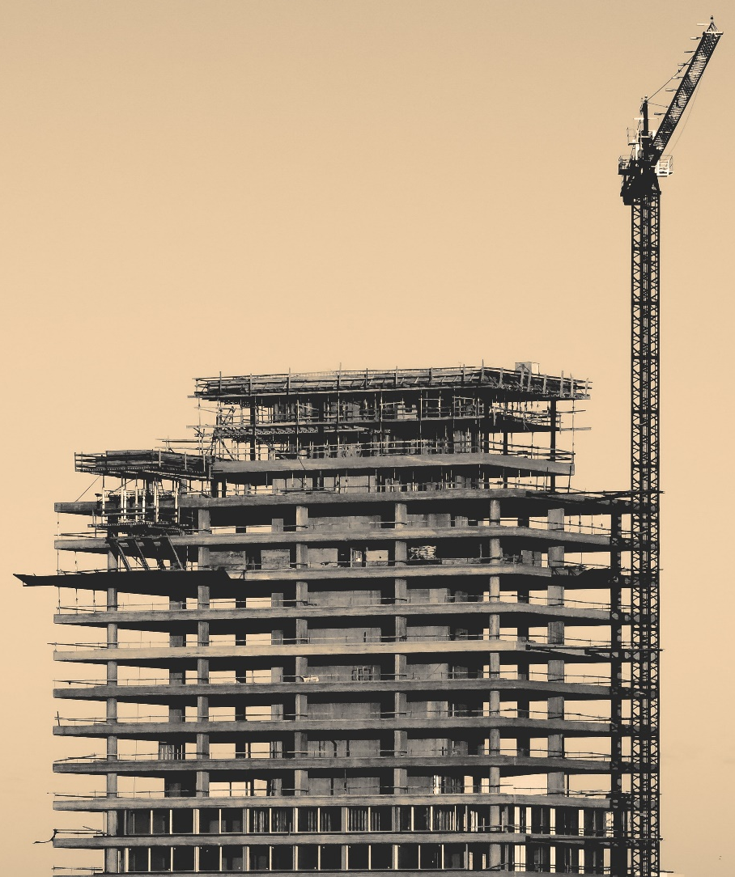
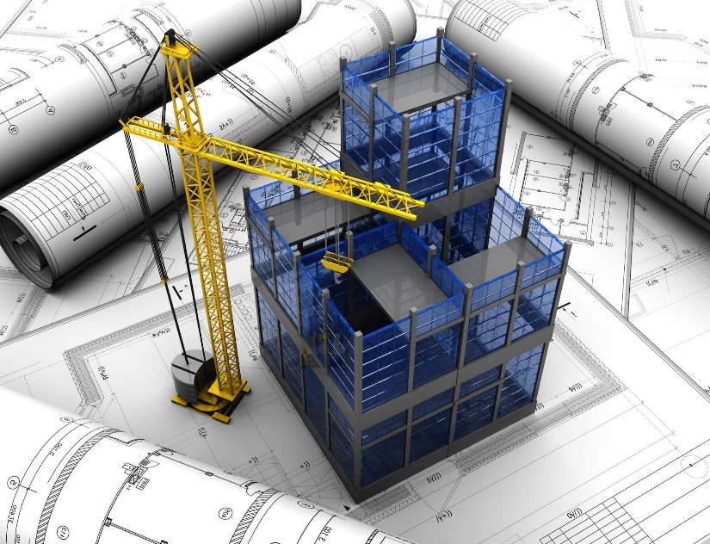


Civil Engineering Contractor ship
Civil engineering is a broad field that encompasses many aspects of infrastructure development and construction. From designing and building roads and bridges to developing sustainable water and wastewater management systems, civil engineers play a critical role in shaping the built environment.
Contracting services is another important aspect of civil engineering. Contractor provide expertise to clients on various infrastructure-related issues, including feasibility studies, project management, and environmental impact assessments. They work closely with clients to develop comprehensive solutions that meet their needs and address the unique challenges of each project.
Piping System
Water Supply System
Internal Road
Steel Structure (build-up Section)
Roofing System of heavy shade
Water Retaining Structure
Water Transmission Pumping gravity
Residential Commercial Construction
Sewerage & drainage system

Slide 10
Advance Geotechnical Soil Investigation & Sub-Surface Coring Services
G&G Engr's provides the entire spectrum of geotechnical engineering capability, from desk study through ground investigation design and supervision, factual reporting, geotechnical interpretation, foundation and stability analysis and design. For a new site, we undertake a geological and structural review followed by a target drilling program to characterize the site's geotechnical conditions.
These programs include both geotechnical, structural and hydrogeological data collection activities. For existing operations, we supply the drilling program by mapping the existing excavations and back-analyzing the geotechnical parameters of existing excavations.
At G&G Engr’s, our geotechnical drilling services provide you with representative samples, supplying the accurate subsurface profile so you can make the appropriate design and engineering decisions. Phases start from scoping level studies, through pre-feasibility study to feasibility studies.
Provides drilling of subsurface cores for bed rock stability analysis and in-situ stress analysis using considerable type of drilling modes for sub-surface core capturing.
Further integration of tomography surveys with the acquired cores to better portray the subsurface model for structure integrity and principal stresses identification of high rises, DAMs, watercourse networking, roads, bridges, railway tracks and for all civil related matters.
Expertise in selecting compatible drilling mode with reference to sub-surface rocks for smooth drilling operation in time efficacy

Slide 11
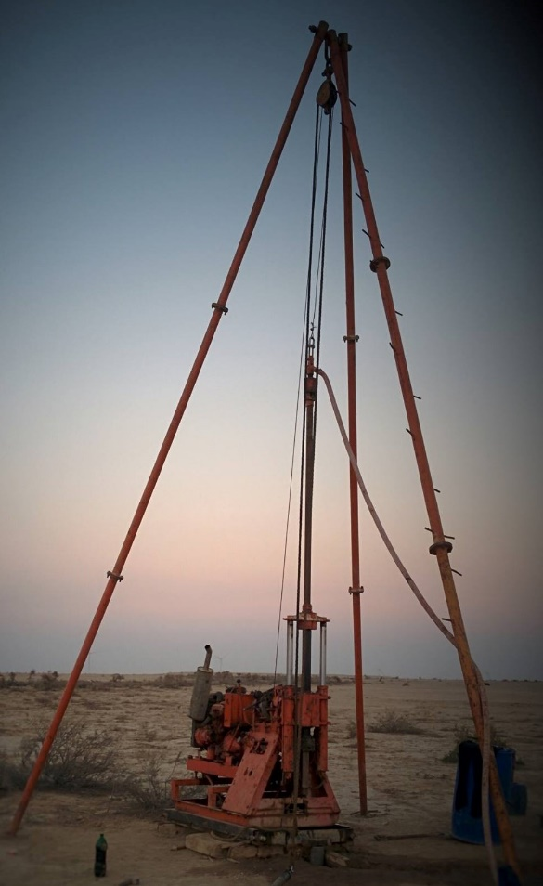
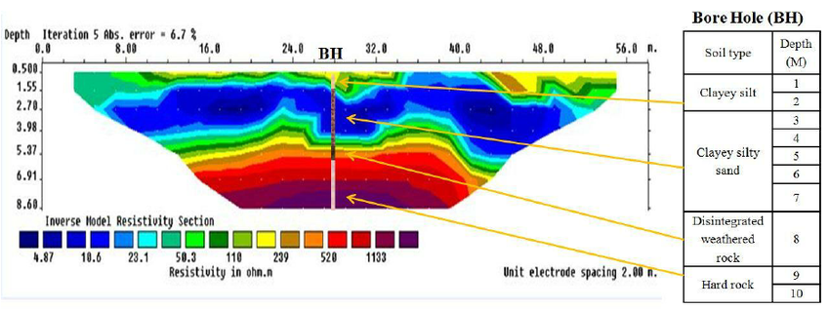
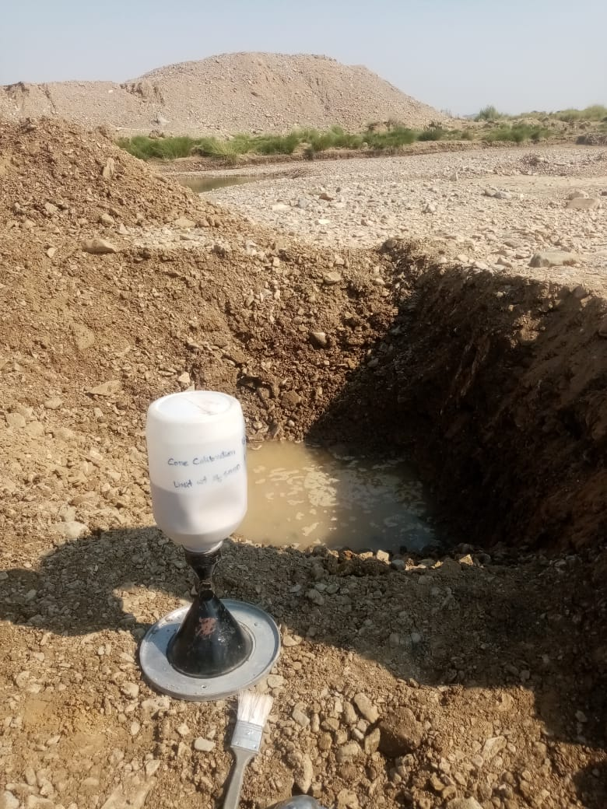
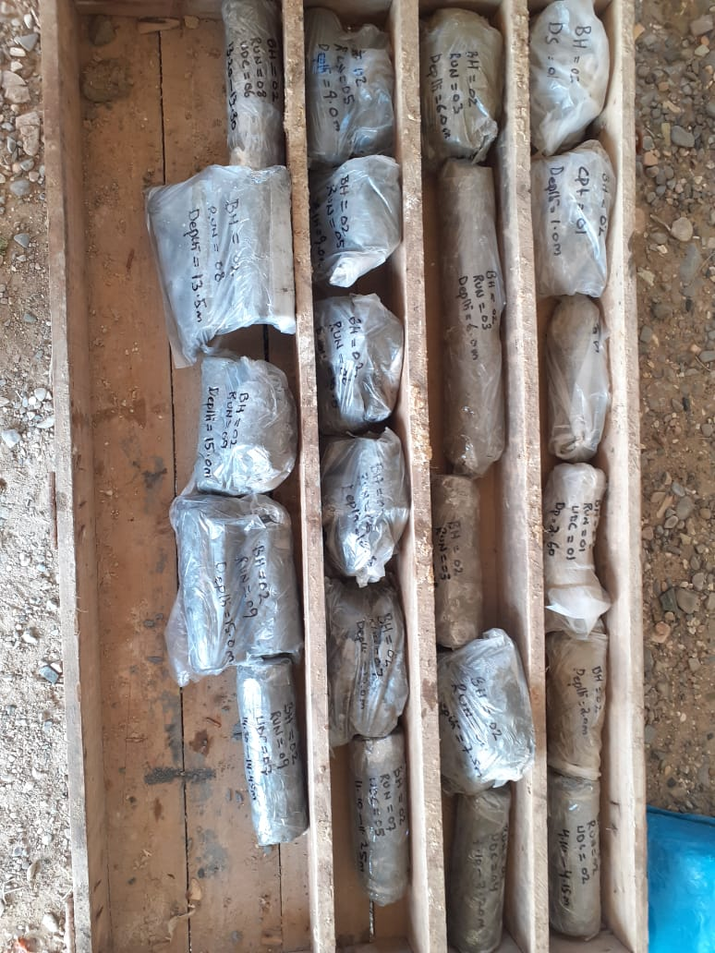
Advance Attribution of Geotechnical Soil Investigation Outlook
Map View of Subsurface
Cross-section View of Subsurface (MASW)
X-section of Subsurface Soil Investigation With ERT Integration
Straight Rotary Rig For Drilling
Field Density Test
Coring For Geotechnical
&
Chemical Analysis

Slide 12
Ground Water Exploration, Subsurface GP Logging
Compatible Drilling Services
Serving the best and the state-of-the-art technologies for exploring and exploiting the ground water with the designing of borehole considering the integrity of water wells.
Surface advance Geophysical tools for ground water exploration to optimize the water location and yield forward anticipations
Drilling of water wells with optimize CAPEX and OPEX is our first and utter most priority with the satisfaction to client.
Sub-surface Geophysical logging to delineate the aquifer zones of interest post drilling. Services covers the main aspects to subject are as follows
Reconnaissance survey of site
Selection of Appropriate methodology of surface Geophysical Survey for Subsurface data
Data point acquisition selection criteria for surface Geophysical Survey for subsurface model
Interpretation and Recommendation of post Survey (Geological Formations, Aquifers presence & anticipated Depths)
Water well location set up for drilling
Subsurface Geophysical wireline logging (Flow zones, delineate aquifer types, Yield capacity)
Selection of well bore casing post Subsurface Geophysical wireline logging
Completion of well (Submersible pump, Riser pipes and associated accessories)
Step-down draw down test for aquifer strength analysis.

Slide 13
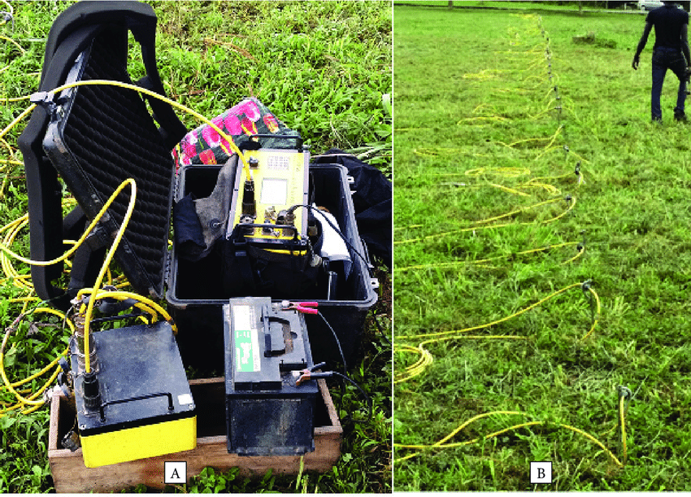
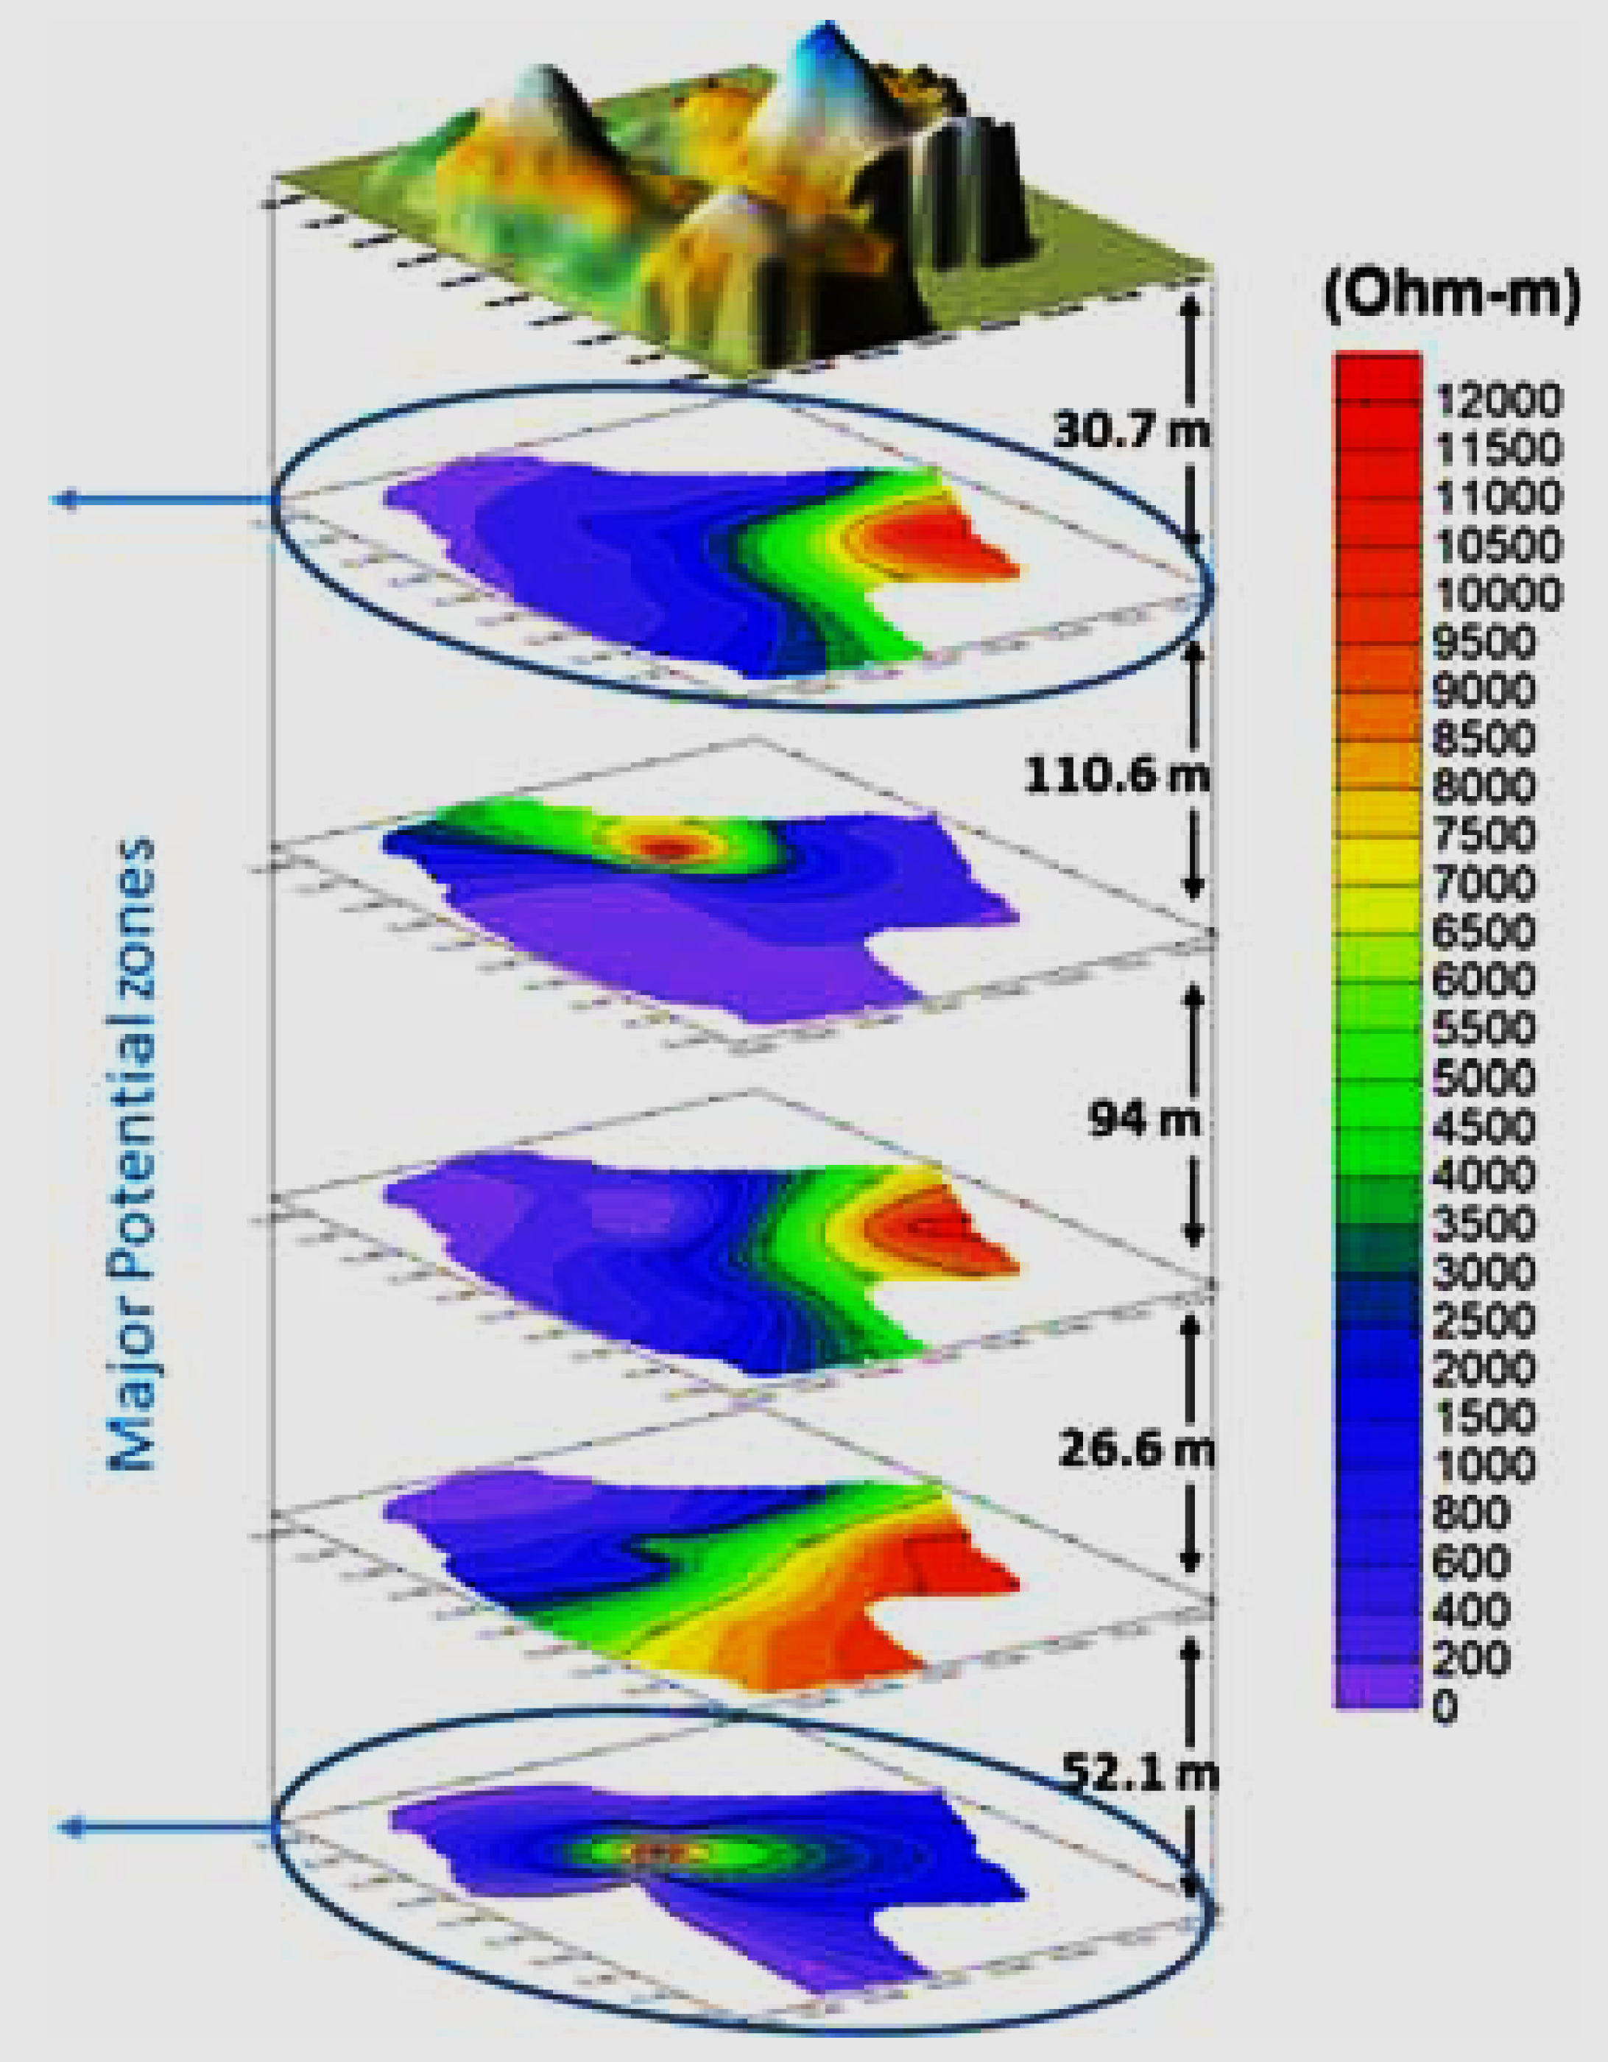
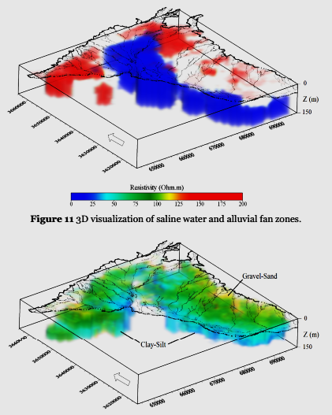
Ground Water Exploration Outlook
Geophysical Equipment
Array Demarcation
Sweet Spots of Aquifer in Layers
X-Section showing Aquifer Extensions
Sweet Spots of Aquifer in 3D Model

Slide 14
Integrated Mineral Exploration
&
Drilling Services
G&G Engineers offer a wide range of exploration services, reflecting our broad geological interests and the diverse expertise of our team. In general, we get involved with projects from grassroots exploration through to the pre-feasibility stage, and these can range from a simple property evaluation and technical report preparation to running and managing entire exploration programs, depending on the client's needs.
As a team, has expertise in a wide variety of geological settings and deposit types. We always adhere to current best practices in health and safety and environmental management, while ensuring that all exploration work is undertaken and completed in compliance with international standards.
G&G Engr’s provides comprehensive geological services to many sectors. We deliver both in-field and desktop services to a diverse range of clients who are interested in mineral exploration and mining. The understanding of the sub-surface geology should always be a key priority and should be supported by good data, whatever the nature of your project. We have the technical "know-how" and the experience to progress a geological project through all of the required stages,
Geological desk studies
Reconnaissance Geological Studies
Surface Geological Exploration Studies
Lithostratigraphic Studies
Structural Studies
Geochemical Studies .

Slide 15
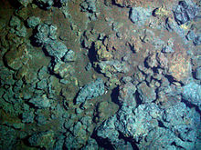
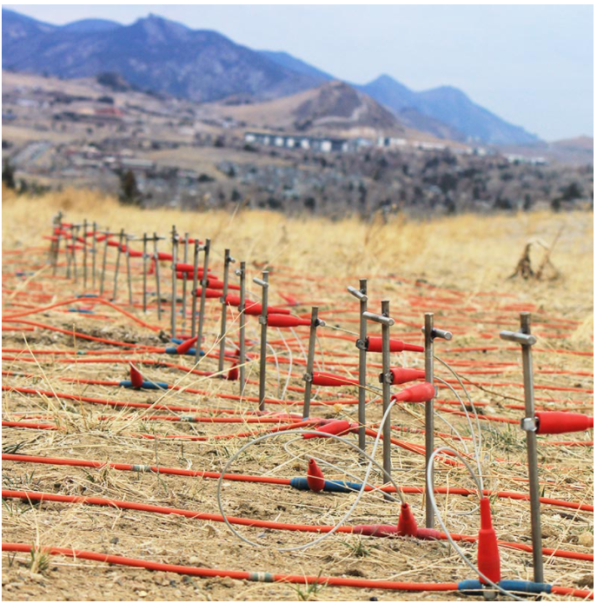
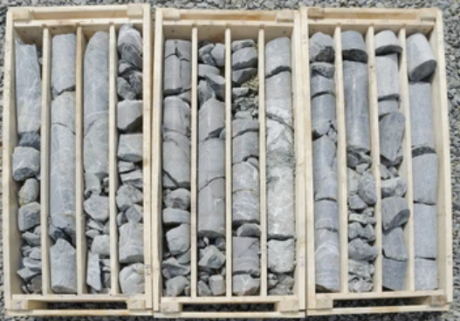
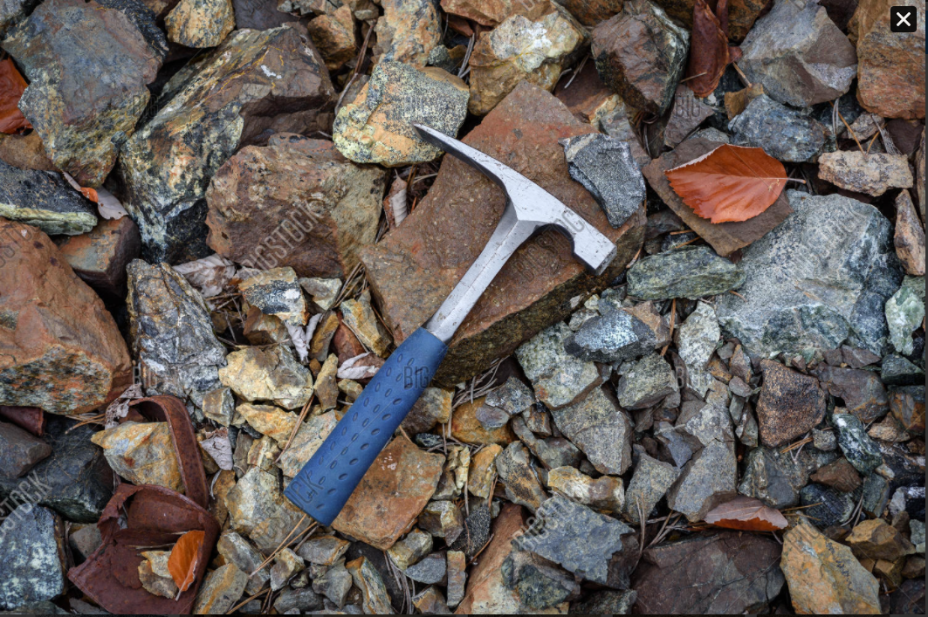
Integrated Mineral Exploration & Drilling Outlook
Data Acquisition
Prospect Mapping
Data Acquisition

Slide 16
Land & Airborne Surveys Services
All land survey and air borne survey services are conducted by our qualified and professional surveyors using our instrumentation and software inventory At G&G Engr’s, we realize and fully understand the importance of survey data we deliver to our clients which is a vital input data into the project design and planning phases.
High quality survey data in terms of accuracy and completeness is guaranteed via faultless and well-defined process of clearly identifying project objectives, professionally supervised field survey and mapping procedures, and more importantly, well established quality control and assurance processes throughout the entire project.
All our deliverables are painstakingly tested and checked in accordance with highest professional standards.
Our land survey services include:
Topographical Survey & DEM Generation
Geological Mapping
Boundary and Setting out Survey
Roads Survey and Cut and Fill Calculations
Quantity Survey (Stockpile measurements)
Mine/Quarry Survey
Our instruments:
Advance SOKKIA Total Station
GNSS-GEOMAX GPS Surveying system
Drone Aerial Land Surveying System

Slide 17
Advance DAMS Geophysics For Subsurface Stability Models
MASW Profile across DAM
Earth Layered Velocity Model
Youngs Modulus
Bulk Modulus
Poisson Ratio
P&S Wave Velocities
Shear Modulus
MAP Section line across DAM
MASW Equipment
ERT Profile 3D MAP across DAM
ERT Profile across DAM

Slide 18
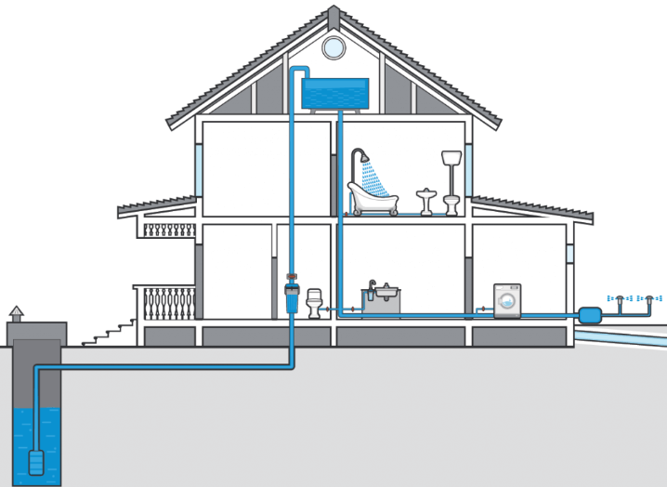
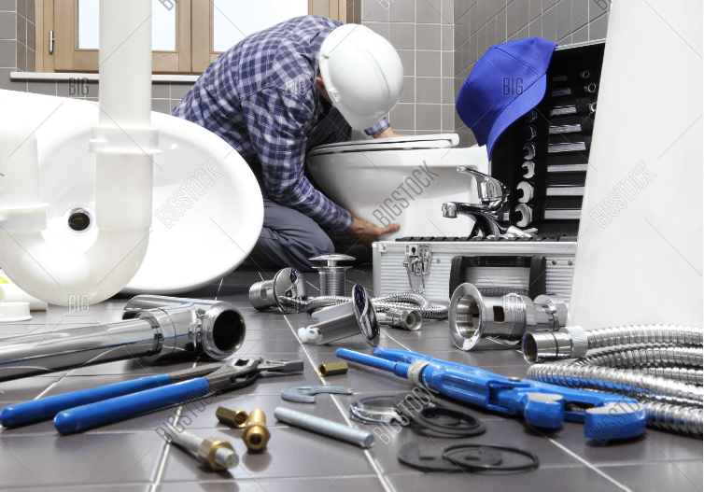
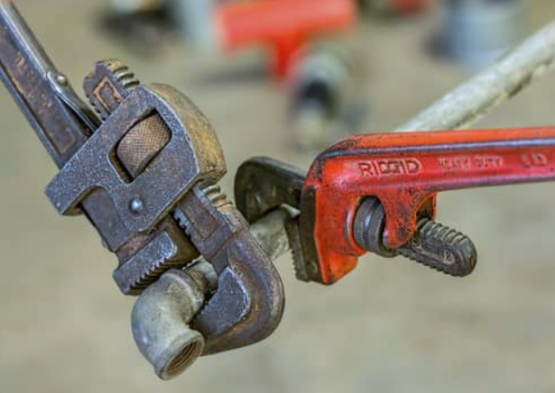
PLUMBING WORKS
"Streamline Your Plumbing Solutions
for Construction Excellence"
The efficiency, reliability, and expertise of our plumbing services, emphasizing their ability to enhance construction projects and contribute to overall excellence. Our key services are as follows,
Design and Installation
Upgrading and Retrofitting
Repair and Maintenance
Compliance with Regulations
Collaboration with Other Trades
Energy and Water Efficiency
Emergency Services

Slide 19
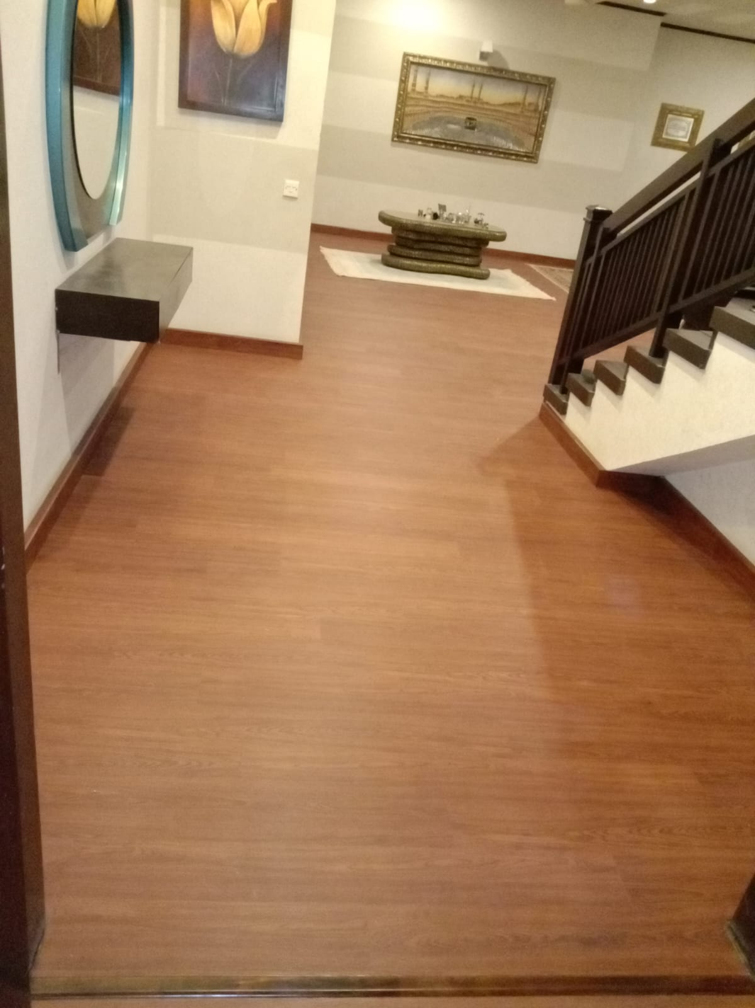
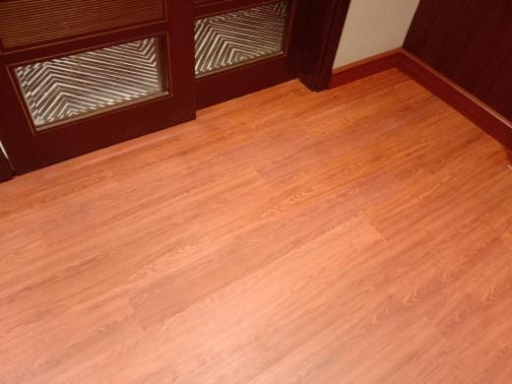
FLOORING WORKS
"Elevate Your Spaces with Exquisite Flooring Craftsmanship"
Our services showcases the craftsmanship, attention to detail, and quality of your flooring services, conveying the idea of transforming spaces into visually stunning and inviting environments. Here are some key points to consider when it comes to flooring services:
Material Selection
Installation Expertise
Customization and Design
Repair and Restoration
Safety and Compliance
Maintenance and Care
Efficiency and Timeliness
Quality Assurance

Slide 20
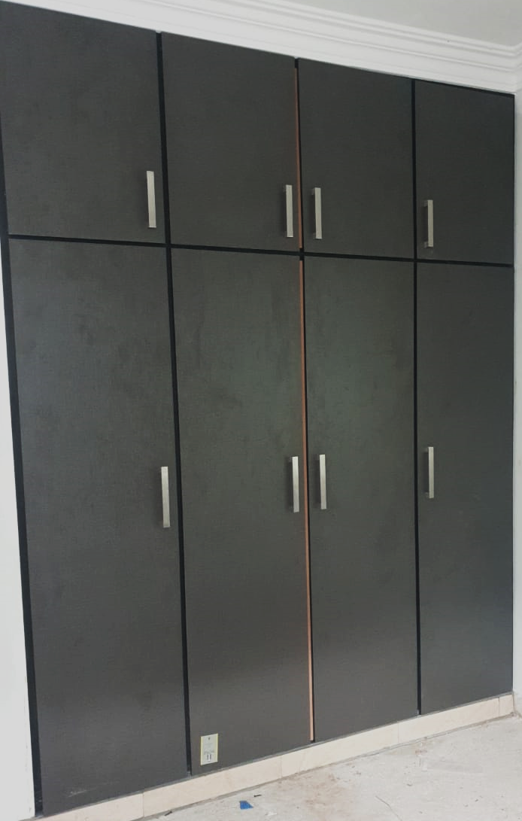
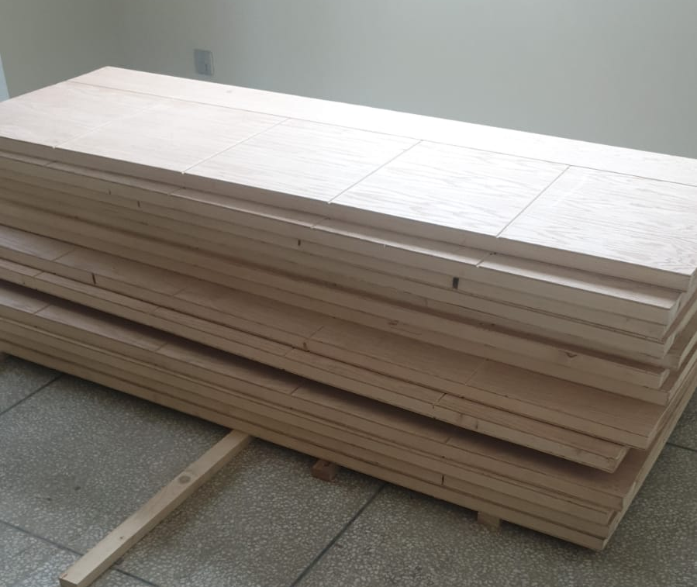
WOOD WORKS
"Unleash the Timeless Artistry of Woodwork in Your Construction Projects"
We captures the elegance, craftsmanship, and timeless appeal of woodwork. It highlights the artistic nature of working with wood and emphasizes the value it adds to construction projects, evoking a sense of beauty, sophistication, and attention to detail.
Key services as follows,
Custom Carpentry
Installation and Finishing
Restoration and Repair
Design Collaboration
Attention to Detail
Integration with Other Trades
Durability and Longevity

Slide 21

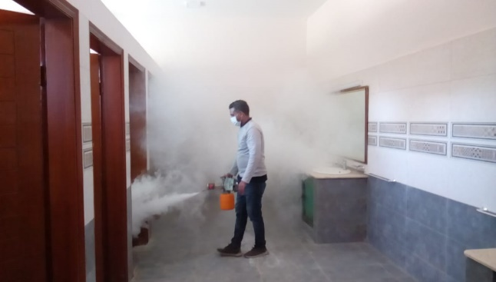
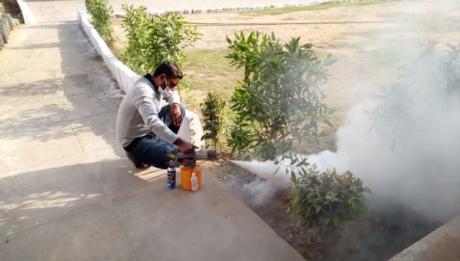
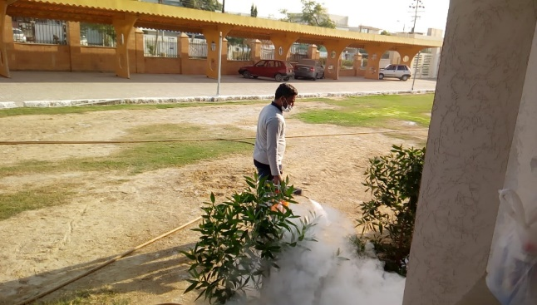
FUMIGATION WORKS
"Pest Eradication Experts
Unleashing a Pest-Free Paradise"
Our company's expertise and effectiveness in eradicating pests through fumigation. It conveys the promise of creating a pest-free paradise, emphasizing the removal of pests and the restoration of a clean and comfortable environment.
Pest Identification
Tailored Solutions
Pre-Construction Measures
Post-Construction Treatments
Safety and Compliance
Integrated Pest Management
Expertise and Experience
Long-Term Prevention

Slide 22

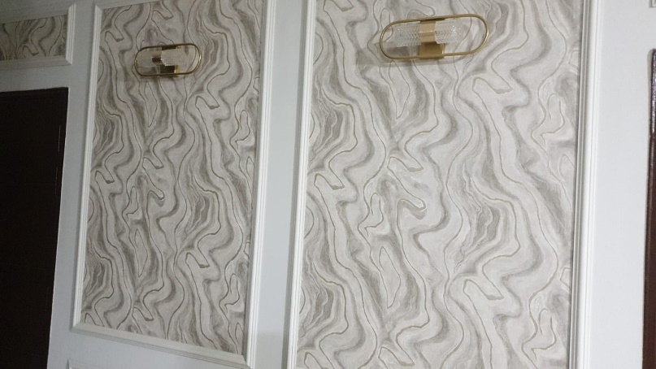
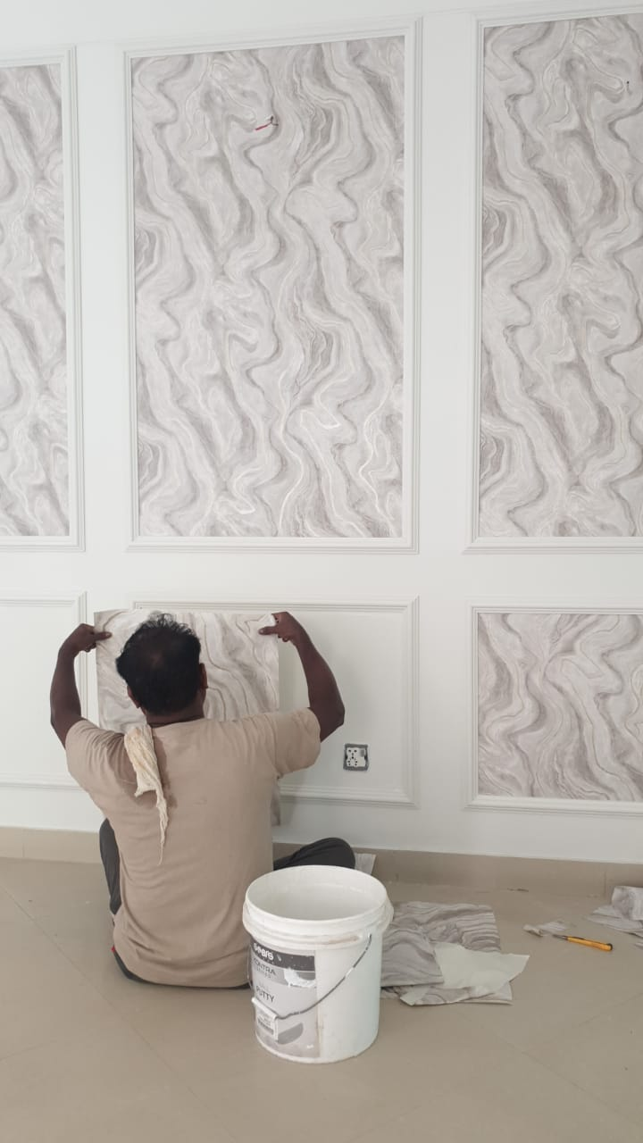
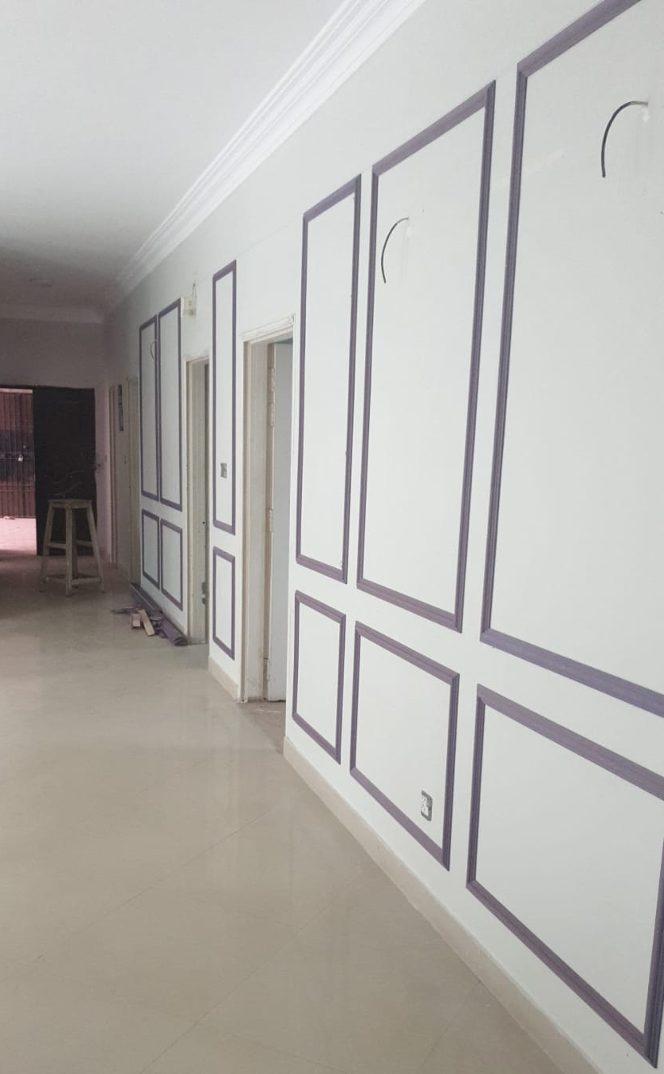
PAINT WORKS
" Vibrant Transformations Masterful Paint and Coloration Craftsmanship"
The captivating and transformative nature of your company's paint and coloration work. It conveys the idea of expertise, artistry, and the ability to create vibrant and visually stunning spaces through skillful craftsmanship.
Color Consultation
Surface Preparation
Paint Application
Specialty Finishes
Environmentally Friendly Solutions
Restoration and Refinishing
Attention to Detail
Project Management

Slide 23
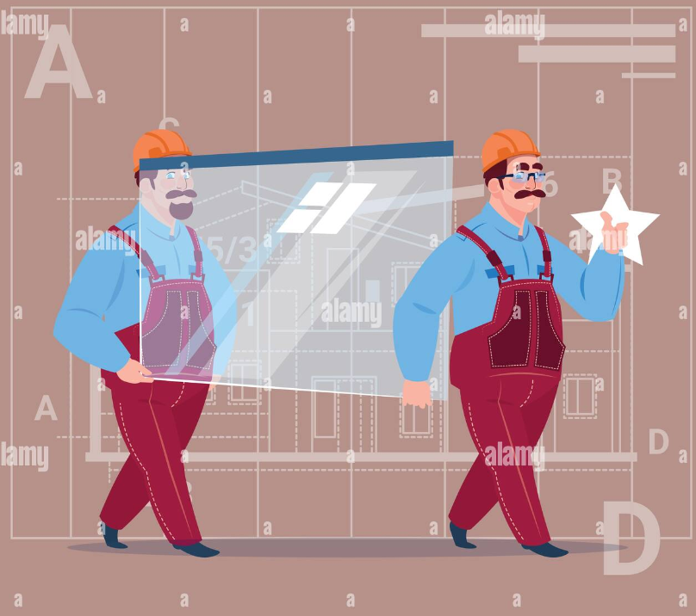
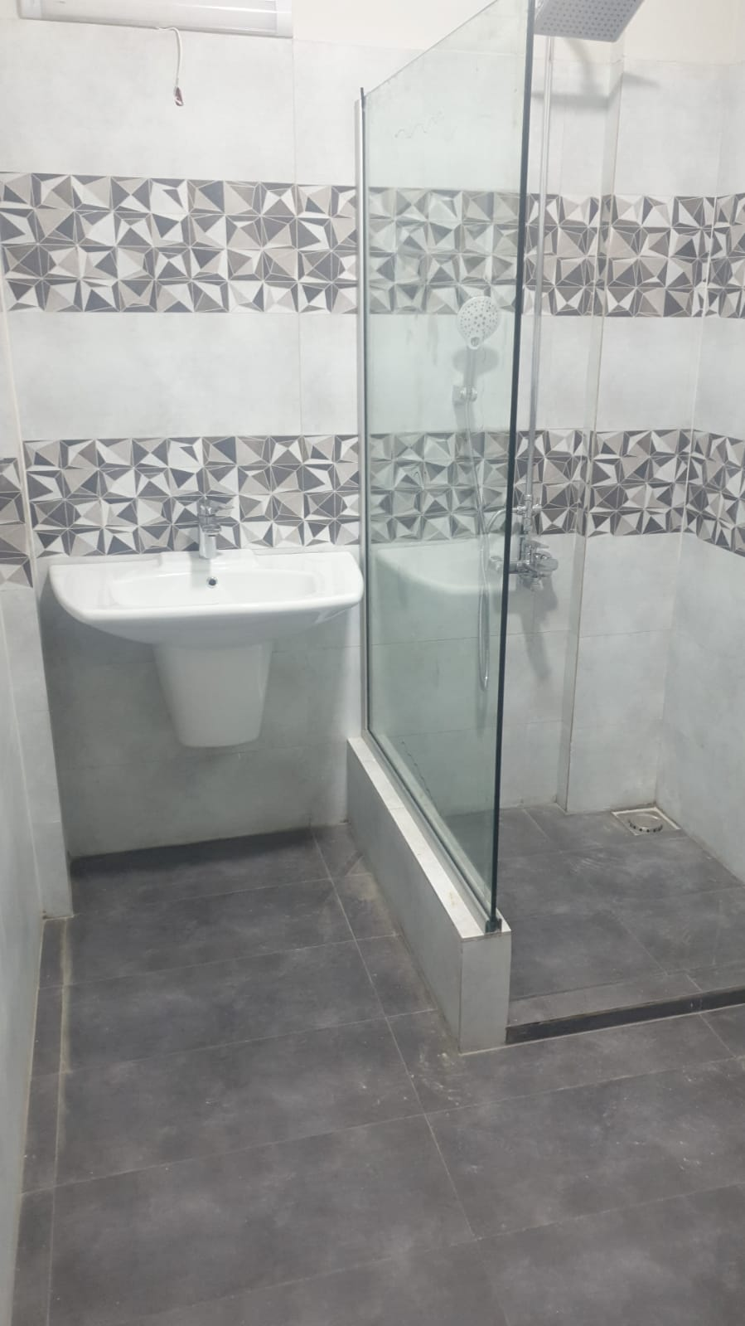
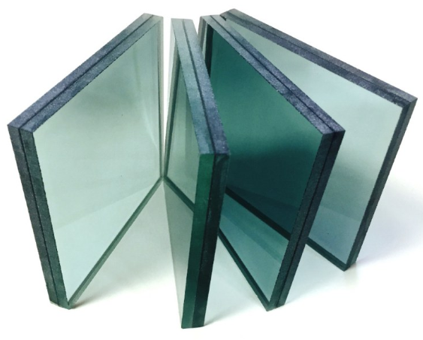
GLASS WORKS
"Transcendent Glass Creations: Artful Glasswork for Construction Excellence"
creating transcendent and visually stunning glass creations, emphasizing the expertise, creativity, and commitment to excellence in the field of glasswork for construction projects.
Custom Glass Solutions:
Expert Installation:.
Natural Light Enhancement:
Visual Openness:.
Design Versatility:
Safety and Security:
Retrofitting and Restoration:.
Maintenance and Repairs:

Slide 24


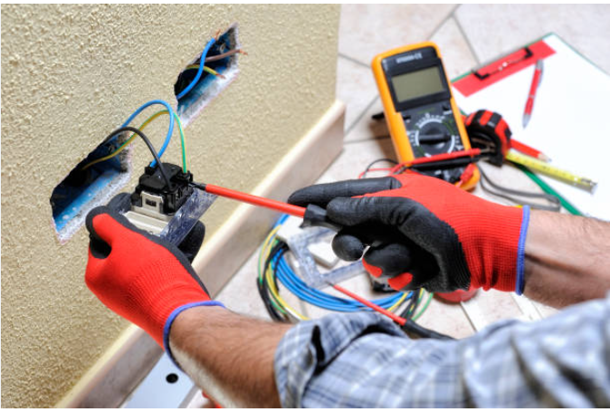
ELECTRIC WORKS
"Empowering Your Spaces: Expert Electrical Solutions for Construction Excellence"
Our company's expertise in providing electrical solutions, conveying a sense of reliability, professionalism, and the ability to deliver excellence in electrical systems for construction and non-construction projects. Our key deliverables are as follows,
Design and Planning
Electrical Installation
Lighting Solutions
Power Distribution
Electrical Upgrades and Retrofits
Safety and Compliance
Data and Communication Systems
Maintenance and Troubleshooting

Slide 25

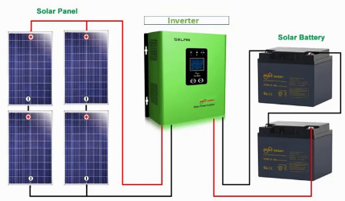
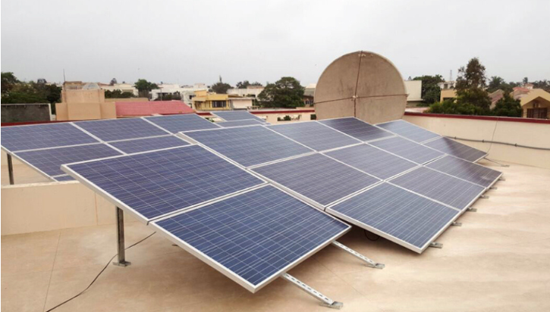
SUSTAINABLE POWER SOLUTIONS
"Solar Brilliance: Masterful Solar Panel Installations for Construction and Sustainability"
Our ability to install solar panels with mastery, contributing to both construction projects and sustainable practices. It highlights the commitment to excellence, innovation, and environmental consciousness in your solar panel installations.
Energy Efficiency:
Customized Solutions: S
Installation Expertise:
Integration with Existing Systems:
Regulatory Compliance:
Monitoring and Maintenance:
Cost Savings:
Environmental Impact:

Slide 26

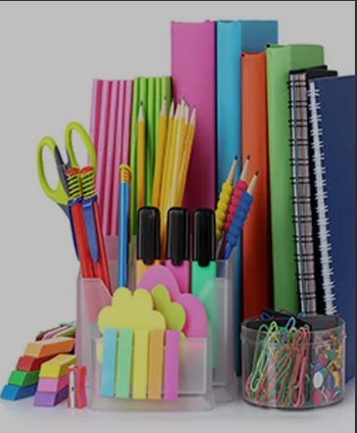
General Order Supply
We deals in supplies of all kind of products for offices, hospitals and other corporate sector,
business groups.
We also provide technical support for oﬀice and hospital equipment on both regular and priority basis.

Slide 27
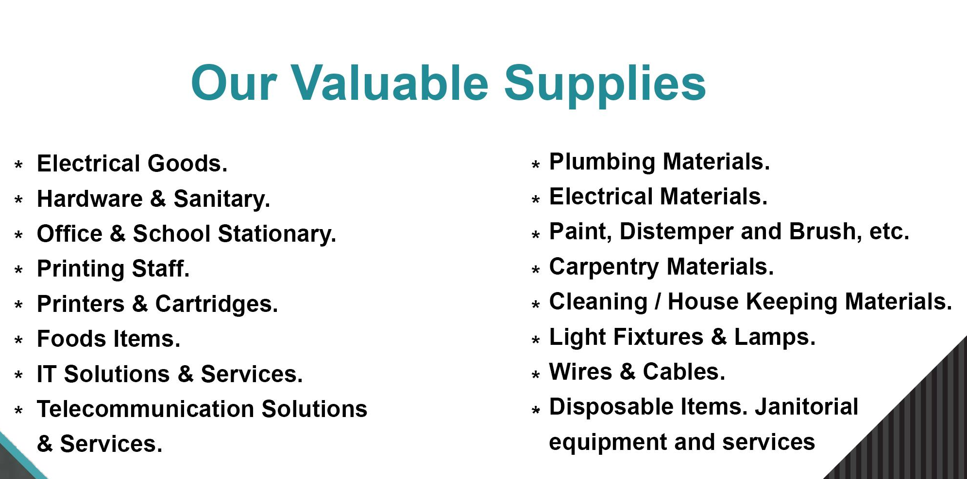
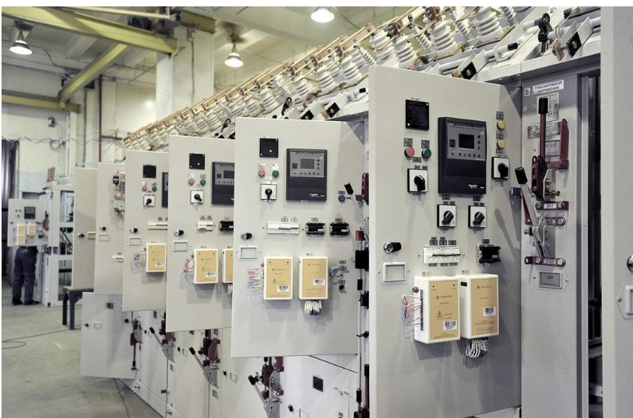
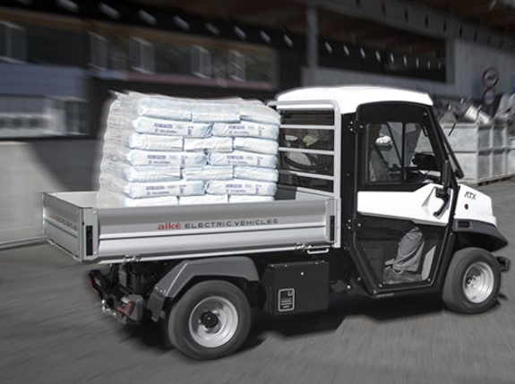

Slide 28

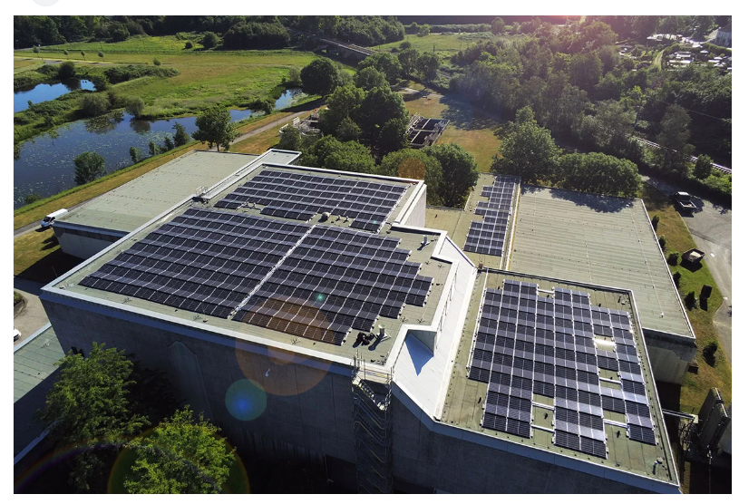
Energy Solutions and Supply
Providing the strength, reliability, and durability demand for today’s industry
Our company offers integrated solutions across multiple markets segments, including energy and infrastructure, industrial processes, building automations, data centers/networks, and a broad presence in residential applications.
Focused on making energy safe, reliable and efficient for our clients.

Slide 29


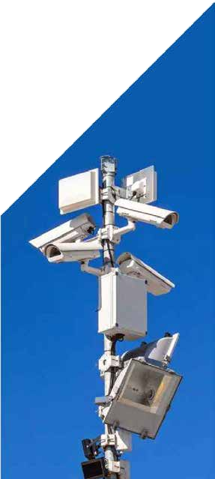
We believe that, in order to create and maintain thriving
planners, city managers, security experts,
enterprise executives, and community
leaders, must work together to achieve true
public safety.
Our tools and solutions extend beyond
physical security to contribute to the
the moﬆ truﬆed brands in security in one
portfolio, we oﬀer the moﬆ comprehensive
range of premium security solutions in the

Slide 30


As an entity, we have been an established and popular Import/Export company with an excellent
We have an excellent staffs who will guide you with their
best ideas by keeping in conﬆant touch with your
Our professional staff of import/export trade specialiﬆs
utilizes their extensive experience to handle all facets

Slide 31
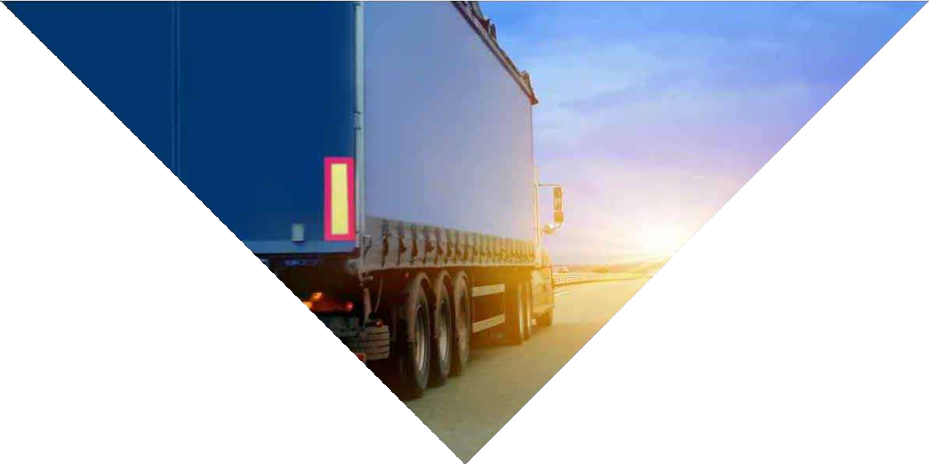


Provides logiﬆics network a wide range of transportation options to support the trucking services.
To meet the challenges of diverse & complex supply
chains, We have developed customers to take full advantage of real time end-to-end shipment & order visibility across their entire supply

Slide 32





We offers a wide spectrum of interior designing, decoration and renovation materials.
We can provide multidimensional products with ease and commitment and can cater with conﬁdence to taste and need of its valued clients on a turnkey basis.
Interior DESIGNING
Project Consultancy
Furnishing all type of Wooden work
Coloring/Paint work
Masonry work including tiles
Electrical Work
Plumbing
False Ceiling
Central Air-conditioning planning with
complete detailed diagrams including
central DUTS, DIFFUSERS, Chillers, etc.
Telephone/PABX
System IT Networking
Security Systems
CCTV Installation
Lighting

Slide 33

Major Client in JV
Medicam Group of Companies
DHA City, Karachi
SECMC (Sindh Engro Coal Mining Company)
Siddiqsons Limited
BIWRMDP (Baluchistan Integrated Water Resources Management & Development Project)
ACC (Agha Construction Company)
JAM Brother& Co.
DHL
ASF Housing Society

Slide 34


Address: C-24/5, Gulshan-e-Iqbal, Karachi
Contact: 0312-2769796
Email : info@gngengineer.com

